Slide 1
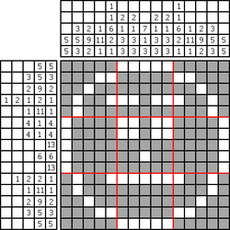
Problem 12936 – Let's build a Nonogram (數織) Validator –

Slide 2
Outline
Description
Input & Output
Concept & Code

Slide 3
Outline
Description
Input & Output
Concept & Code

Slide 4
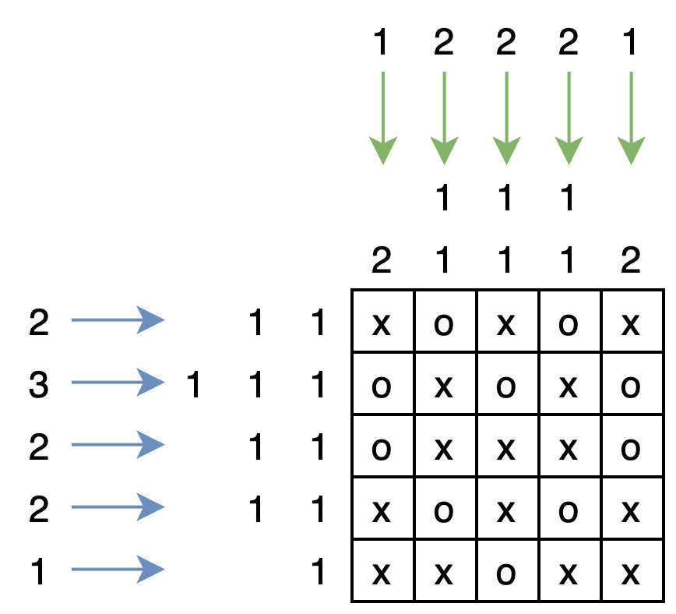
Description
Nonogram (數織) is a puzzle solving game.
You are given an empty 2D matrix, and your goal is to color some grids to fit given conditions.
Given conditions: There is a list of numbers beside each row and column, which tells you the length of each consecutive colored grid of that row/column.

Slide 5
Outline
Description
Input & Output
Concept & Code

Slide 6
Input – T, N, M
The first line contains an integer T, representing that your sister has just finished T Nonograms.
Then for each Nonogram, the first line contains 2 integers N, M, representing the numbers of rows and columns of the Nonogram, respectively.
1 <= T <= 10, 1 <= N, M <= 45
M
2
5 5
N

Slide 7
Input – Row Lists
2 1 1
2 colored grids: length 1, length 1
3 1 1 1
3 colored grids: length 1, length 1, length 1
2 1 1
2 colored grids: length 1, length 1
2 1 1
2 colored grids: length 1, length 1
1 1
1 colored grid: length 1

Slide 8
Input – Column Lists
1 2
1 colored grid: length 2
2 1 1
2 colored grids: length 1, length 1
2 1 1
2 colored grids: length 1, length 1
2 1 1
2 colored grids: length 1, length 1
1 2
1 colored grid: length 2

Slide 9
Input - Nonogram
Lastly, each of the following N lines has M characters, representing the Nonogram your sister has finished, where the character 'o' represents that the grid is colored, while the character 'x' represents that the grid is not colored and empty.
xoxox
oxoxo
oxxxo
xoxox
xxoxx
x | o | x | o | x
o | x | o | x | o
o | x | x | x | o
x | o | x | o | x
x | x | o | x | x

Slide 10
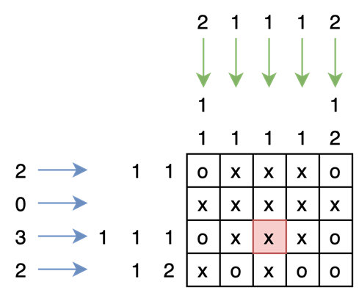
Output
output "Yes" (without quotes)
output "No" (without quotes)

Slide 11
Outline
Description
Input & Output
Concept & Code

Slide 12
main(): Read Row Lists
2
5 5
2 1 1
3 1 1 1
2 1 1
2 1 1
1 1
1 2
2 1 1
2 1 1
2 1 1
1 2
int main(){
scanf("%d", &T);
while(T--){
scanf("%d %d", &N, &M);
for(int i=0; i<N; i++){
scanf("%d", &r_len[i][0]);
for(int j=1; j<=r_len[i][0]; j++) scanf("%d", &r_len[i][j]);
}
for(int i=0; i<M; i++){
scanf("%d", &c_len[i][0]);
for(int j=1; j<=c_len[i][0]; j++) scanf("%d", &c_len[i][j]);
}
for(int i=0; i<N; i++) scanf("%s", Nonogram[i]);
for(int i=0; i<M; i++) Nonogram[N][i] = '\0';
printf(solved() ? "Yes\n" : "No\n");
}
return 0;
}
r_len
2 | 1 | 1
3 | 1 | 1 | 1
2 | 1 | 1
2 | 1 | 1
1 | 1
The first element of each row means the number of colored grids in that row.

Slide 13
main(): Read Column Lists
2
5 5
2 1 1
3 1 1 1
2 1 1
2 1 1
1 1
1 2
2 1 1
2 1 1
2 1 1
1 2
int main(){
scanf("%d", &T);
while(T--){
scanf("%d %d", &N, &M);
for(int i=0; i<N; i++){
scanf("%d", &r_len[i][0]);
for(int j=1; j<=r_len[i][0]; j++) scanf("%d", &r_len[i][j]);
}
for(int i=0; i<M; i++){
scanf("%d", &c_len[i][0]);
for(int j=1; j<=c_len[i][0]; j++) scanf("%d", &c_len[i][j]);
}
for(int i=0; i<N; i++) scanf("%s", Nonogram[i]);
for(int i=0; i<M; i++) Nonogram[N][i] = '\0';
printf(solved() ? "Yes\n" : "No\n");
}
return 0;
}
c_len
1 | 2
2 | 1 | 1
2 | 1 | 1
2 | 1 | 1
1 | 2
The first element of each row means the number of colored grids in that column.

Slide 14
main(): Read Nonogram
1 2
2 1 1
2 1 1
2 1 1
1 2
xoxox
oxoxo
oxxxo
xoxox
xxoxx
int main(){
scanf("%d", &T);
while(T--){
scanf("%d %d", &N, &M);
for(int i=0; i<N; i++){
scanf("%d", &r_len[i][0]);
for(int j=1; j<=r_len[i][0]; j++) scanf("%d", &r_len[i][j]);
}
for(int i=0; i<M; i++){
scanf("%d", &c_len[i][0]);
for(int j=1; j<=c_len[i][0]; j++) scanf("%d", &c_len[i][j]);
}
for(int i=0; i<N; i++) scanf("%s", Nonogram[i]);
for(int i=0; i<M; i++) Nonogram[N][i] = '\0';
printf(solved() ? "Yes\n" : "No\n");
}
return 0;
}
x | o | x | o | x | \0
o | x | o | x | o | \0
o | x | x | x | o | \0
x | o | x | o | x | \0
x | x | o | x | x | \0
\0 | \0 | \0 | \0 | \0

Slide 15
solved() – Idea
r_len
2 | 1 | 1
3 | 1 | 1 | 1
2 | 1 | 1
2 | 1 | 1
1 | 1
Whenever encountering a char that is not ‘o’ (‘x’ or ‘\0’) and a colored grid with length > 0 has been found, compare the length of the found colored grid with the corresponding value in r_len or c_len.
x | o | x | o | x | \0
o | x | o | x | o | \0
o | x | x | x | o | \0
x | o | x | o | x | \0
x | x | o | x | x | \0
\0 | \0 | \0 | \0 | \0
c_len
Find a colored grid with length = 1
1 | 2
2 | 1 | 1
2 | 1 | 1
2 | 1 | 1
1 | 2

Slide 16
solved() – Idea
r_len
2 | 1 | 1
3 | 1 | 1 | 1
2 | 1 | 1
2 | 1 | 1
1 | 1
Whenever encountering a char that is not ‘o’ (‘x’ or ‘\0’) and a colored grid with length > 0 has been found, compare the length of the found colored grid with the corresponding value in r_len or c_len.
x | o | x | o | x | \0
o | x | o | x | o | \0
o | x | x | x | o | \0
x | o | x | o | x | \0
x | x | o | x | x | \0
\0 | \0 | \0 | \0 | \0
c_len
Find a colored grid with length = 2
1 | 2
2 | 1 | 1
2 | 1 | 1
2 | 1 | 1
1 | 2

Slide 17
solved() – Implementation
The last char ‘\0’ allows to count the last colored grid.
cnt : current colored grid length
idx : the idx^{th} colored grid length to check
for(int i=0; i<N; i++){
int idx = 0, cnt = 0;
for(int j=0; j<=M; j++){
if(Nonogram[i][j] == 'o') cnt++;
else if(cnt > 0){ //must be a 'x' or '\0'
//the corresponding grid lengths are not matched
if(cnt != r_len[i][++idx]) return 0;
//reset length
cnt = 0;
}
}
}
r_len
x | o | x | o | o | \0
2 | 1 | 2
cnt = 1, idx = 1
Matched !
cnt = 2, idx = 2
cnt = 1, idx = 0
cnt = 1, idx = 1
cnt = 0, idx = 0
cnt = 2, idx = 1

Slide 18
solved() – Implementation
for(int i=0; i<N; i++){
int idx = 0, cnt = 0;
for(int j=0; j<=M; j++){
if(Nonogram[i][j] == 'o') cnt++;
else if(cnt > 0){ //must be a 'x' or '\0'
//found more grids than expected
if(idx == r_len[i][0]) return 0;
//the corresponding grid lengths are not matched
if(cnt != r_len[i][++idx]) return 0;
//reset length
cnt = 0;
}
}
//found less grids than expected
if(idx != r_len[i][0]) return 0;
}
Excluding the current found grid, the number of expected grids r_len[i][0] has already been reached!
At last, check if there are remaining expected grids that are still not matched!

Slide 19
int solved(){
for(int i=0; i<N; i++){
int idx = 0, cnt = 0;
for(int j=0; j<=M; j++){
if(Nonogram[i][j] == 'o') cnt++;
else if(cnt > 0){ //must be a 'x' or '\0'
//found more grids than expected
if(idx == r_len[i][0]) return 0;
//the corresponding grid lengths are not matched
if(cnt != r_len[i][++idx]) return 0;
//reset length
cnt = 0;
}
}
//found less grids than expected
if(idx != r_len[i][0]) return 0;
}
for(int j=0; j<M; j++){
int idx = 0, cnt = 0;
for(int i=0; i<=N; i++){
if(Nonogram[i][j] == 'o') cnt++;
else if(cnt > 0){ //must be a 'x' or '\0'
//found more grids than expected
if(idx == c_len[j][0]) return 0;
//the corresponding grid lengths are not matched
if(cnt != c_len[j][++idx]) return 0;
//reset length
cnt = 0;
}
}
//found less grids than expected
if(idx != c_len[j][0]) return 0;
}
return 1;
}
Check rows
Check columns
If all the rows and columns are matched, just return 1 in the end.

Slide 20
End

